Slide 1

Introduction
to
Computer Science
CS101.3
Lecture #09
Pramudya Thilakaratne pramudya.h@nsbm.ac.lk
Lecturer
Faculty of Computing
NSBM Green University

Slide 2
Welcome to Lecture 09!
Take your notebooks and prepare
You can ask questions via either chat message or over the mic.
When you are not using the mic please mute it.

Slide 3

From Last Week
Twos Complement Representation

Slide 4
Computer Storage Structure
Computer storage contains many computer components that are used to store data. It is traditionally divided into primary storage and secondary storage.

Slide 5
Primary Storage
Primary storage is also known as the main memory and is the memory directly accessible by the CPU.
Examples
ROM
RAM
Cache Memory

Slide 6
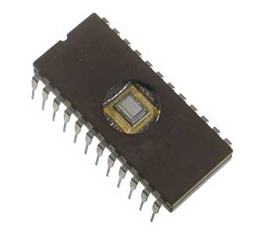
ROM
ROM stands for Read Only Memory
This memory cannot be changed, it can only be read when required
Since ROM is unchangeable memory, it is used by data and programs that are frequently required and which is not change often, something like system boot program.

Slide 7
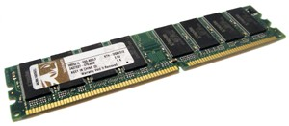
RAM
RAM stands for Random Access Memory
It is a volatile memory, meaning of that is the data in RAM is lost when the power is switched off.
RAM is the major form of primary memory as it is quite fast and also quite expensive

Slide 8
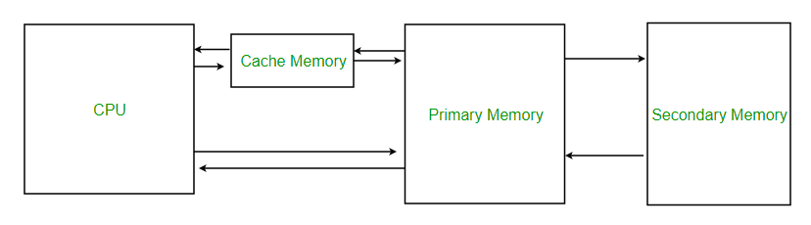
Cache Memory
Cache is used to store data and instructions that are frequently required by the CPU so it doesn’t have to search them in the main memory.
This is a small memory that is also very fast

Slide 9
Secondary Storage
Secondary or external storage is not directly accessible by the CPU.
The data from secondary storage needs to be brought into the primary storage before the CPU can use it.
Secondary storage contains a large amount of data permanently.
The different types of secondary storage devices are
Hard Disk
Floppy Disk
Memory Cards
Flash Drives
CD-ROM

Slide 10

Resume @ 10.50am

Slide 11
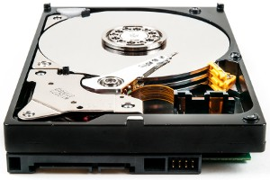
Hard Disk Drive (HDD)
Hard disks are the most famously used secondary storage devices.
They are round, flat pieces of metal covered with magnetic oxide
They are available in many sizes ranging from 1 to 14 inch diameter

Slide 12
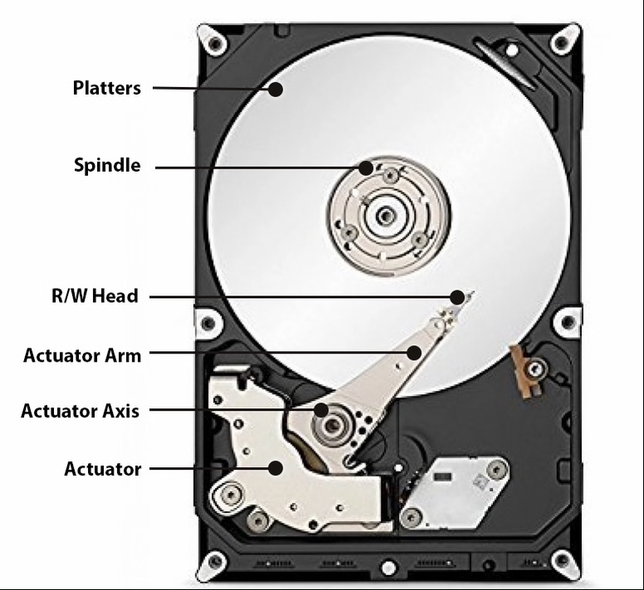
Parts of a Hard disk

Slide 13
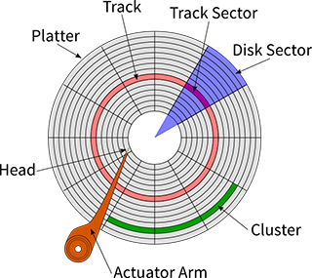
Data storing inside HDD
Before using the hard disk, it is formatted to create tracks and sectors

Slide 14
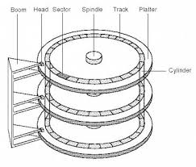
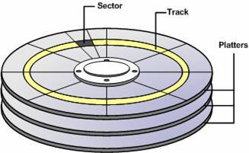
Data storing inside HDD
To increase the capacity same hard disk have more then one platter
Following diagram, it contains 3 platters that means 6 surfaces.

Slide 15

How HDD Works

Slide 16
HDD Calculations
Q. A magnetic disk have 5 platters, 4000 tracks on each surface and 20 sectors per track. The capacity of a sector is 2KB
Find the capacity of a track
Capacity of the track = No. of Sectors per track x size of the sector
= 20 x 2 KB = 40KB

Slide 17
HDD Calculations
Q. A magnetic disk have 5 platters, 4000 tracks on each surface and 20 sectors per track. The capacity of a sector is 2KB
Find the capacity of surface
Capacity of a surface = capacity of a track x No. of tracks in surface
= 20 x 2 x 4000 KB

Slide 18
HDD Calculations
Q. A magnetic disk have 5 platters, 4000 tracks on each surface and 20 sectors per track. The capacity of a sector is 2KB
Find the capacity of total HDD
Capacity of HDD = capacity of a surface x No. of Surfaces
= 20 x 2 x 4000 x 10 KB

Slide 19
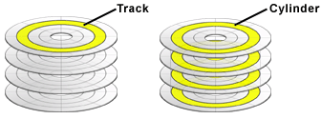
HDD Calculations
Q. A magnetic disk have 5 platters, 4000 tracks on each surface and 20 sectors per track. The capacity of a sector is 2KB
Find the capacity of a Cylinder
Capacity of a cylinder = Capacity of a track x No. of Surfaces
= 20 x 2 x 10 KB

Slide 20
TASK 01
Q. A magnetic disk have 10 platters, 2000 tracks on each surface and 30 sectors per track. The capacity of a sector is 4KB
Find the capacity of a track
Find the Capacity of a surface
Find the capacity of the total HDD
Find the capacity of a cylinder

